Slide 1
Learn to anticipate
Chana Ross
December 2019

Slide 2
Problem Definition
Mathematical breakdown of problem
Anticipatory planner – mathematical background
Example – Uber , Manhattan
Data analysis
Probability function
Deterministic problem solvers
Anticipatory algorithm
Results
Future work
Summary
Table of contents

Slide 3
Input
Limited known number of agents
Goal
Maximize amount of requests answered throughout a given day using a set number of agents
Real time requests created throughout time (stochastic)
Historical data of previous requests
Minimize overall use of each agent
“On-line Continual Planning Problem – OCPP”
Problem Definition
Anticipatory on-line planning, ICAPS’12
Ethan Burns, J. Benton, Wheeler Ruml, Sungwook Yoon, and Minh B. Do.
Notes:
This is a general problem definition. There are many real world problems that we can define in this structure.
The main point here is that the environment and actions of agents are deterministic, but the goals wanted at each time are stochastic and therefore the problem is stochastic as well.
(if it were deterministic goals we could have solved it using MIP or other methods that we will see later in this presentation)
The basis for our research was presented by wheeler and his team in ICAPs in 2012

Slide 4
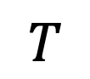


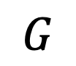
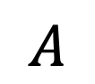
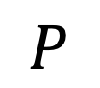
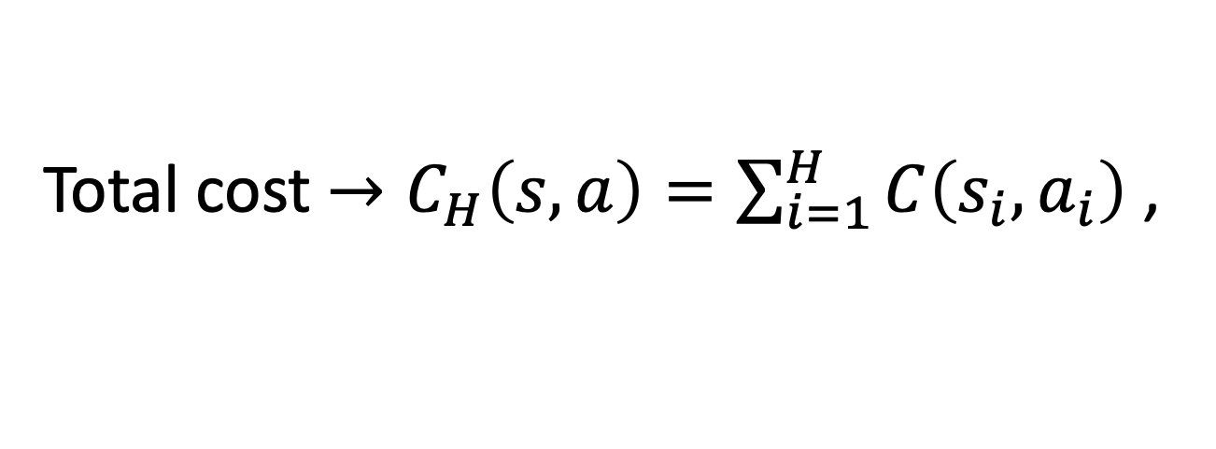
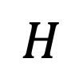
World (agents)
Known goals (requests)
Available actions
Transition function probability from S’ to S
Cost of preforming action A given state S
Number of look ahead steps
Distribution of future goals
$$W$$
$$G$$
OCPP - Problem Definition
$$A$$
$$T$$
$$C_{H}$$
$$H$$
$$P$$
Anticipatory on-line planning, ICAPS’12
Ethan Burns, J. Benton, Wheeler Ruml, Sungwook Yoon, and Minh B. Do.
Total cost $→C_{H}\left(s,a\right)=\sum_{i=1}^{H}{C\left(s_{i},a_{i}\right)}$ ,
S=<W,G>
Notes:
Before we go on solving the problem we want to define some notations that will be used throughout the presentation.
Assuming we have a world with goals that are created throughout time from a transition function which takes us at each timestep from state S to S’.
At each time we have set of agents that can preform a number of actions – A, these actions are known and similar at each time.
The cost of preforming the actions is also known and is effected by the ability of our agents to supply the goals.
The problem changes throughout time therefore there is no need to plan a full policy but only to determine H steps ahead at each given time.
P is the distribution of future events

Slide 5
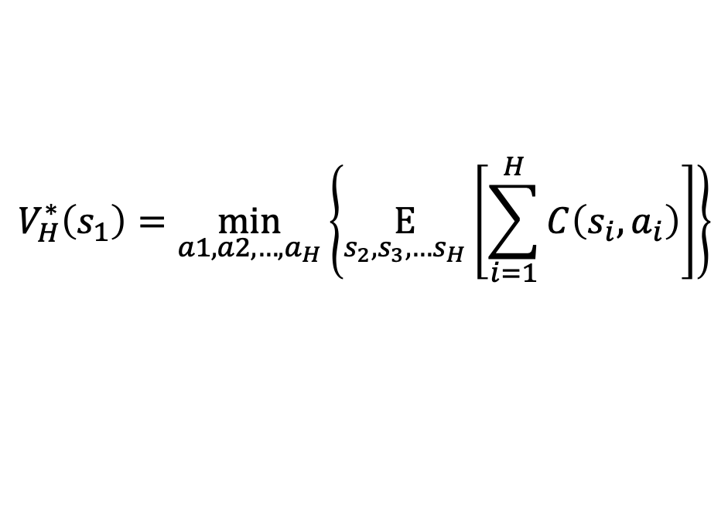

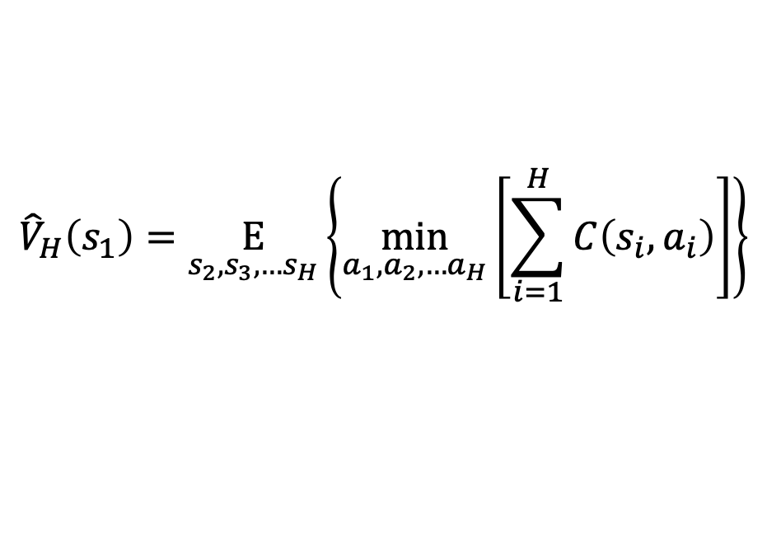
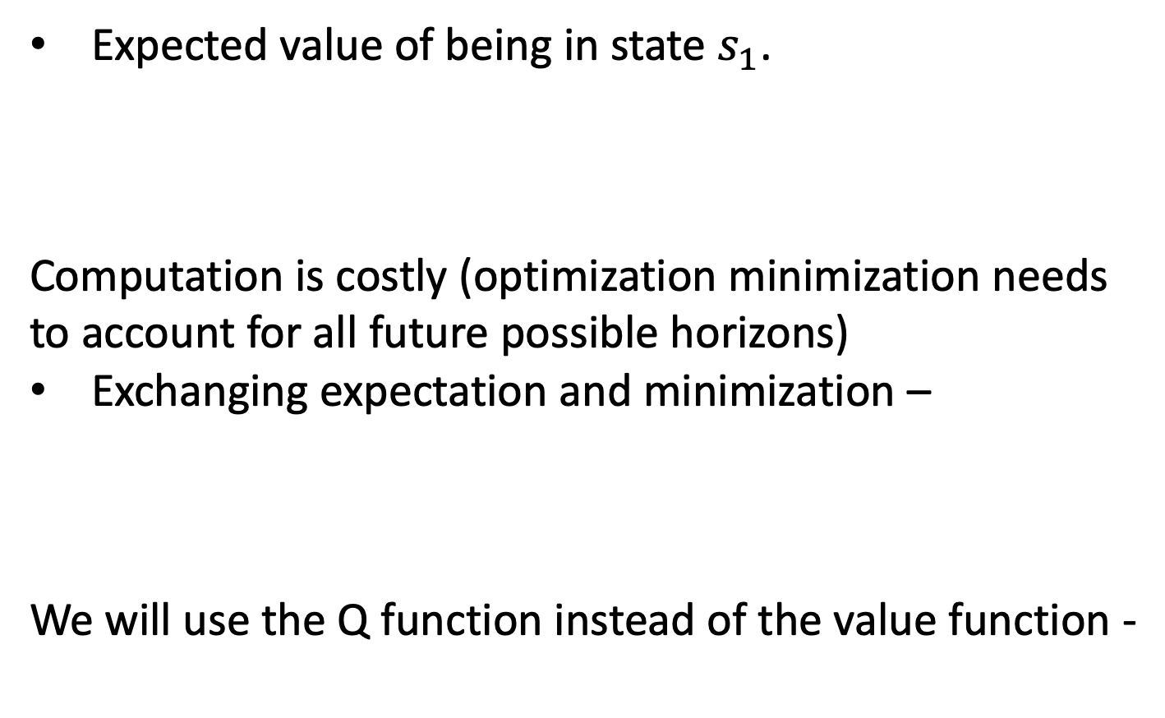
Expected value of being in state $s_{1}$.
Computation is costly (optimization minimization needs to account for all future possible horizons)
Exchanging expectation and minimization –
We will use the Q function instead of the value function -
$$V_{H}^{∗}\left(s_{1}\right)=\min_{a1,a2,…,a_{H}}\left\{\underset{s_{2},s_{3},…s_{H}}{E}\left[\sum_{i=1}^{H}{C\left(s_{i},a_{i}\right)}\right]\right\}$$
Anticipatory planner – mathematical background
$${\hat{V}}_{H}\left(s_{1}\right)=\underset{s_{2},s_{3},…s_{H}}{E}\left\{\min_{a_{1},a_{2},…a_{H}}\left[\sum_{i=1}^{H}{C\left(s_{i},a_{i}\right)}\right]\right\}$$
$$\hat{Q}\left(s_{1},a_{1}\right)=C\left(s_{1},a_{1}\right)+{\hat{V}}_{H}\left(s_{1}\right)$$
Anticipatory on-line planning, ICAPS’12
Ethan Burns, J. Benton, Wheeler Ruml, Sungwook Yoon, and Minh B. Do.
Notes:
Our goal is to maximize the total reward given assuming some policy. In order to estimate this reward we need to think of each action and ask ourselves what is the maximum expected reward from this action forwards.
If the problem is deterministic this expected reward is known and can be calculated, but when we have some aspect of randomness or stochasiticy in our problem we need to estimate this reward.
Our goal is to find the expected reward for each combination of actions and then choose the actions that maximize that reward
Here we can see the function of expected reward for state S1.
This function says we need to find the actions that minimize all future costs assuming all possible states
This is a complex and costly function to calculate so we try a greedy approach where we flip the expectation and minimization in order to find the expected value of choosing optimal actions per a given horizon.
Finally what we actually want to look at is the Q function and not the value function.

Slide 6
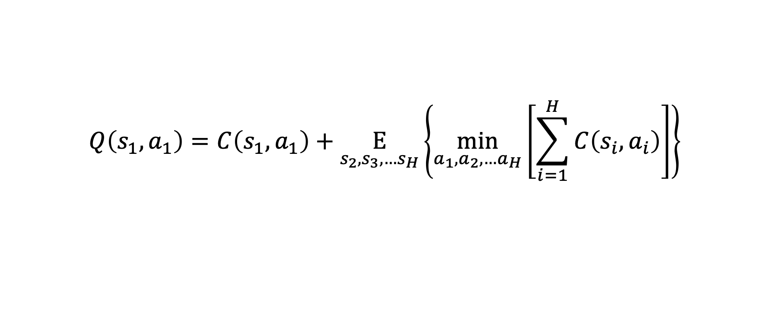
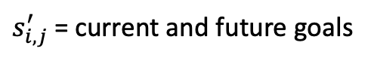
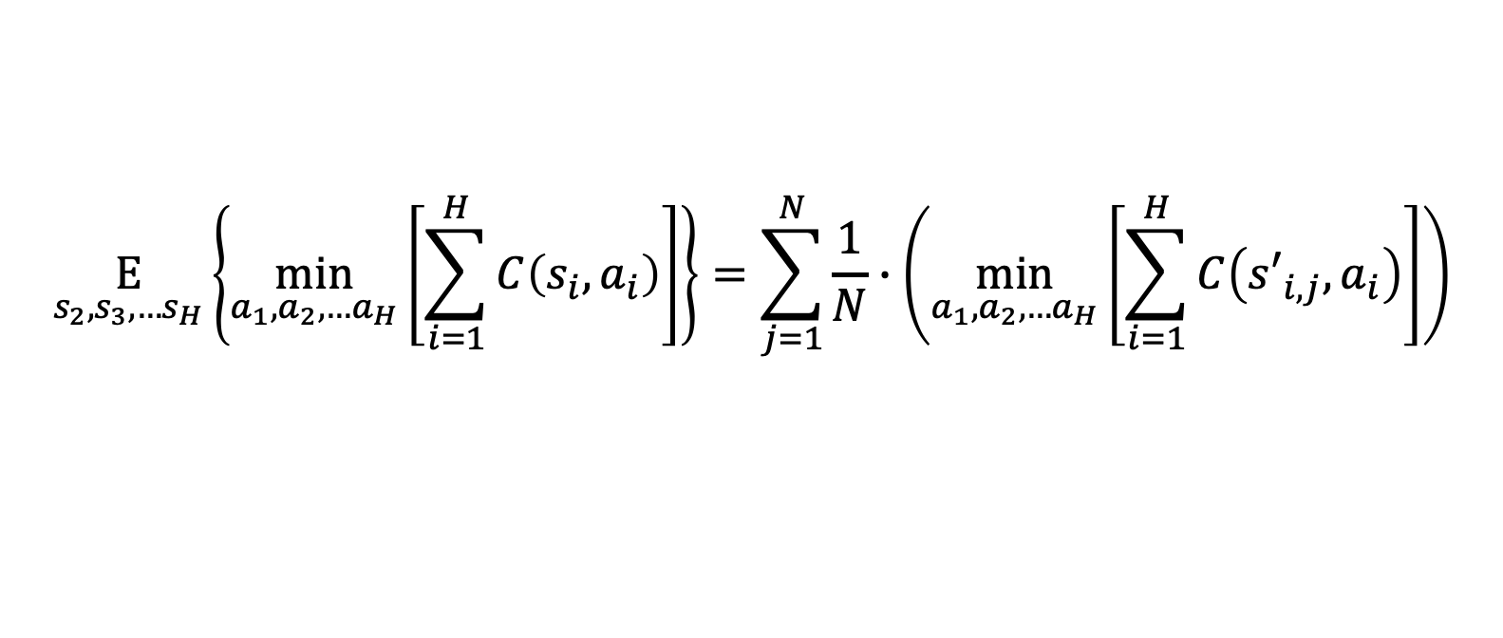
Expected goals from distribution
$$Q\left(s_{1},a_{1}\right)=C\left(s_{1},a_{1}\right)+\underset{s_{2},s_{3},…s_{H}}{E}\left\{\min_{a_{1},a_{2},…a_{H}}\left[\sum_{i=1}^{H}{C\left(s_{i},a_{i}\right)}\right]\right\}$$
Anticipatory planner - explained
Real cost of moving each vehicle and picking up goals reached
Deterministic problem of real goals and future goals sampled from known distribution
$$\underset{s_{2},s_{3},…s_{H}}{E}\left\{\min_{a_{1},a_{2},…a_{H}}\left[\sum_{i=1}^{H}{C\left(s_{i},a_{i}\right)}\right]\right\}=\sum_{j=1}^{N}{\frac{1}{N}∙\left(\min_{a_{1},a_{2},…a_{H}}\left[\sum_{i=1}^{H}{C\left({s′}_{i,j},a_{i}\right)}\right]\right)}$$
Anticipatory on-line planning, ICAPS’12
Ethan Burns, J. Benton, Wheeler Ruml, Sungwook Yoon, and Minh B. Do.
$s_{i,j}^{′}$ = current and future goals
N = num stochastic runs
Notes:
once we understand the general equation we are trying to solve, now we need to break down each part and figure out how we are going to calculate it using the data and information we have.
the first part is easily calculated since it is known and determinsitic. given a set of opened goals and locations of agents in the world we know how much it will cost us to preform an action from the set of known actions.
the 2nd part of this equation assumes we know the probability function of future goals since we need to estimate the expected value of preforming the chosen action assuming these future goals. therefore the missing part here is knowing the probability function.
the 3rd part assumes we know how to solve the deterministic problem. assuming we know all the goals,actions and enviroment, what is the optimial policy?
finally we can see that the expected value can be the sum of all minimization results for each horizon found when drawing from future events

Slide 7
 | “Anticipatory online planning” Bernie et al. | Our solution
Distribution | Known function | Learned from historical data
Deterministic Solver (run time) | A* Slow run time Limited problem size | MIP Fast (max flow) Problem size unlimited
Problem Size | 3 agents 7*7 grid P(1 event) = 0.04 | 5+ agents 50*10 grid (not limited) P(multiple events) > 0.1
What’s new?
Anticipatory on-line planning, ICAPS’12
Ethan Burns, J. Benton, Wheeler Ruml, Sungwook Yoon, and Minh B. Do.
Notes:
our work is based strongly on an article published by wheeler and his team in ICAPS in 2012. in this work they defined the problem and found a solution using a known distribution. in addition they assumed a small enviroment and limited number of agents.
here we can see a comparison between our work and theirs.
our main contribution is in combining machine learning algorithms in order to estimate the probability function and also in order to allow for larger real world size problems.
our goal is to be able to give a broad solution for any team that has historical data and a way to define/solve their deterministic problem

Slide 8
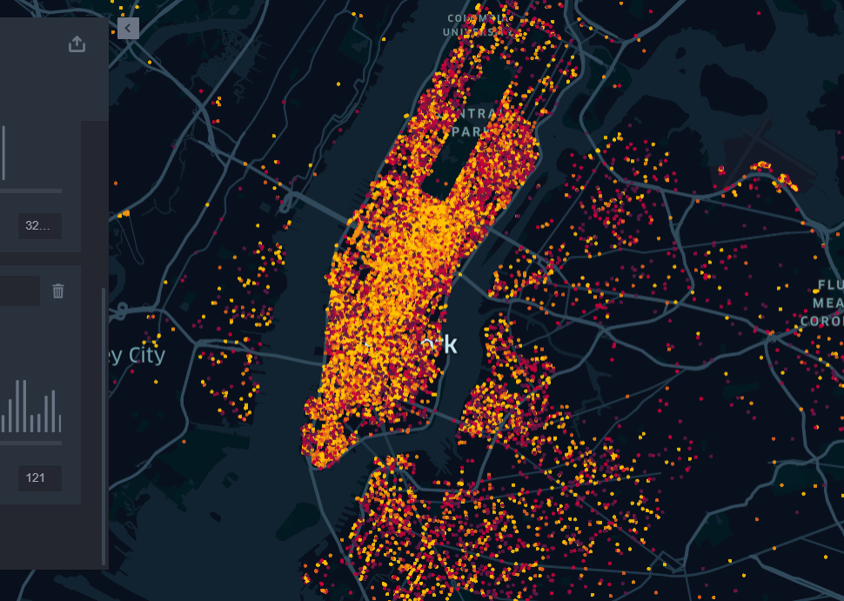
Example – Uber Manhattan
Notes:
a classic example for this type of problem is ride sharing taxis.
this has become an interesting topic in the past few years, especially since autonoumus cars are emerging and once they exist a smart planner will be essensial.
we have chosen to show our results on uber in manhattan since there is a large amount of historical data online on this topic

Slide 9
Data
Input
April - September 2014
https://github.com/fivethirtyeight/uber-tlc-foil-response
Number of available drivers
Stochastic requests throughout the day
Goal
Baseline
Minimize route for each driver
Maximize amount of requests answered
Deterministic optimal solution
Greedy linear sum assignment based on distance matrix
Problem Definition Uber
Notes:
* our first step was making sure there is enough data to be used for the prediction learning.
we found this data set and many more that have a row of information for each uber ride in manhattan during the period of time.
* in this problem the input is a known number of uber drivers and some historical information of previous demands in manhattan.
* our goal is to find a policy that minimizes the route each driver has to do but also maximizes the amount of requests answered.
* we compare our results to two main baselines -
1. the optimal solution assuming the determinstic problem where the requests are known at the beginning of the day (similar to package delivery services)
2. the greedy approach where at any given time a linear sum assignmenet matching algorithm is preformed. (a new policy is created every time a car reaches a request / a new request come in)

Slide 10
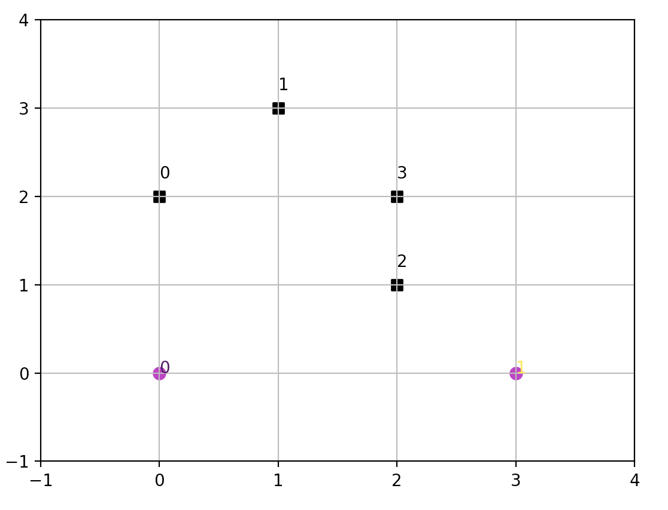

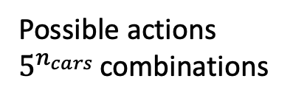
Cost : [reward for pickup] - [cancelation fee] - [driving fee]
Cancellation time
Problem Assumptions
Possible actions
$5^{n_{cars} }$combinations
Costumers
cars
Notes:
here we can see an example of our enviroment.
at a certain time we can see that we have 2 cars and 4 requests opened
* each car can preform 5 actions - {up, down, right, left, stay}
which means that at each time we have 5^cars combinations.
* each costumer waits a known time before canceling its offer (this time is not known to the solver)

Slide 11
1. Data Analysis
Organize data
Understand patterns (if exist)
2. learning prediction function
learn the historical data and create probability function to estimate expected value of actions
3. Deterministic solver
Find solver for calculating expected value of deterministic runs
4. anticipatory algorithm
5. Accelerate run time
run anticipatory algorithm and compare to baselines
improve run time and run on large-scale problems
Steps for solution
Notes:
in order to solve this problem we had to do the following steps:
1st we needed to analyze the data and understand how we want to present it in a way that could be calculated and used for our calculations.
2nd we took the data and tried to learn it and create a probability function for the future based on the past. we tried two approaches , one was data driven and the other was more advanced machine learning techniques.
3rd we defined the deterministic problem as a classic planning problem and searched for quick ways to solve it (since this algorithm will be run multiple times for each time step)
Once all the preparation was done we could use the anticipatory algorithm introduced by wheeler and his team and see if we achieved better results than the benchmark
Finally we are trying to reduce run time using different techniques

Slide 12
Grid Rotation
Data Cropped : Manhattan
Limited number of events (<20)
$$Δt=30 min. Δx,Δy=500 m$$
Δt=30 min. Δ𝑥,Δ𝑦=500 𝑚
Step 1 : Data analysis
Notes:
Our goas was to translate the real data into a more efficient representation and one that would be easier to compute.
We therefore decided to rotate the data
Crop out only Manhattan
And bin each time and location into a grid like format so that we could analyze a number of events per bin,
We also limited the amount of events possible at each location and time, assuming that above that number the algorithm would not be effected (since having 20 events or more most likely produces a similar result)

Slide 13
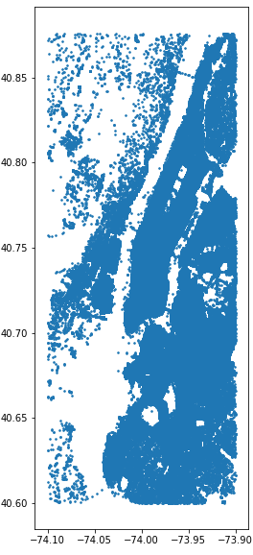
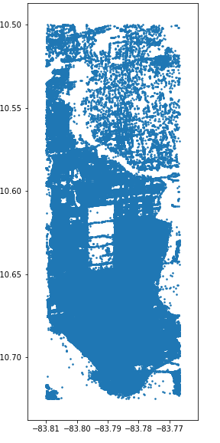
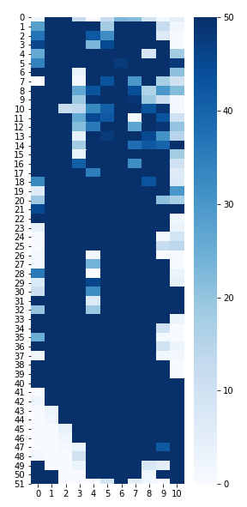
Rotated + Cropped data
Original data
Aggregated
Step 1 : Data analysis
Central park
Notes:
On the left we can see the original data.
Each point on the graph is a costumer that is picked up throughout the 6 months.
This is a representation of the costumers lat, lon
In the middile graph we can see the same data only now it is cropped and rotated
And the 3rd graph shows the final representation of the bins, each 500 m long.
We have a total problem of 51*11 in the special dimension

Slide 14
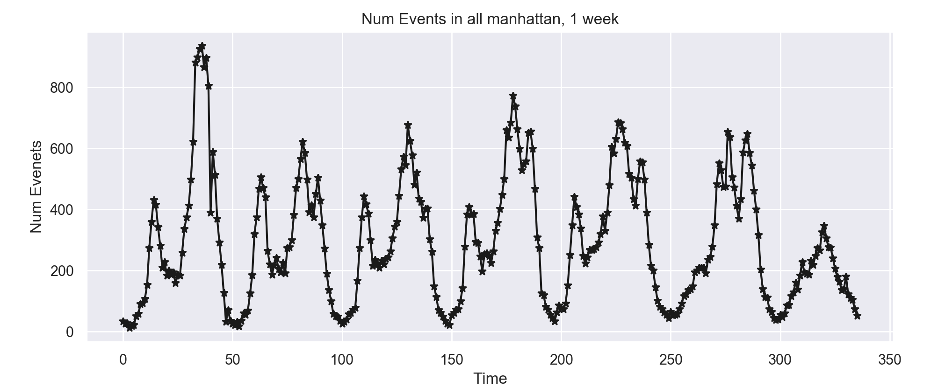
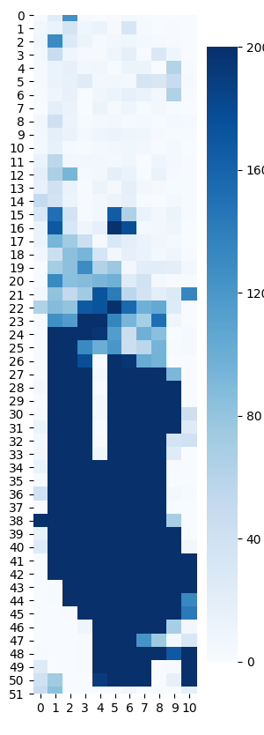
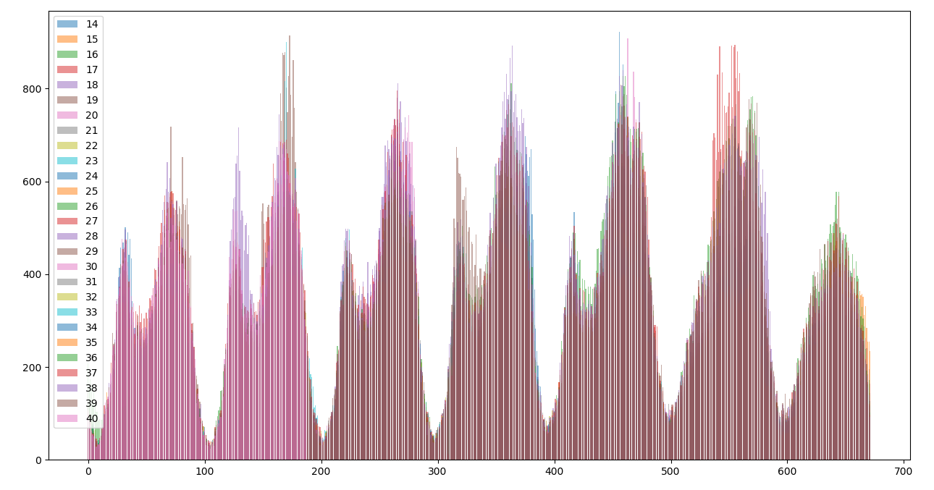
Temporal distribution, all locations, 1 week
Spatial Distribution , 1 week
Step 1 : Data analysis
All weeks have similar behavior
Notes:
in this figure we can see all the date presented on one graph.
the x axis is one week and the y axis shows the sum of events at each time during that week.
each color is a different week from januray - september.
we can se that most weeks have a clear pattern and also each day cleary has a morning and evening peek.
in this graph we can see one of those weeks more in depth
the graph on the right shows the same data but in a spasial format where each bin is a sum of the whole week.
we can see clearly that most requests are from the mid- downtown area.

Slide 15
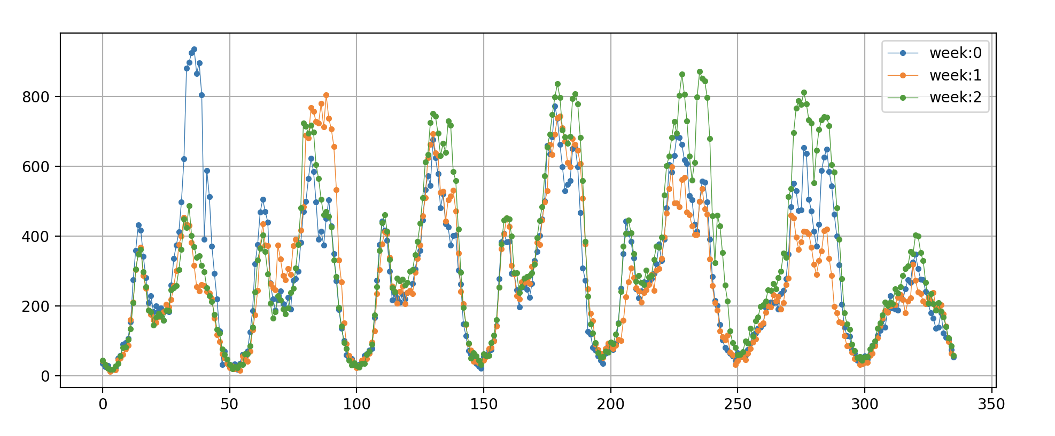
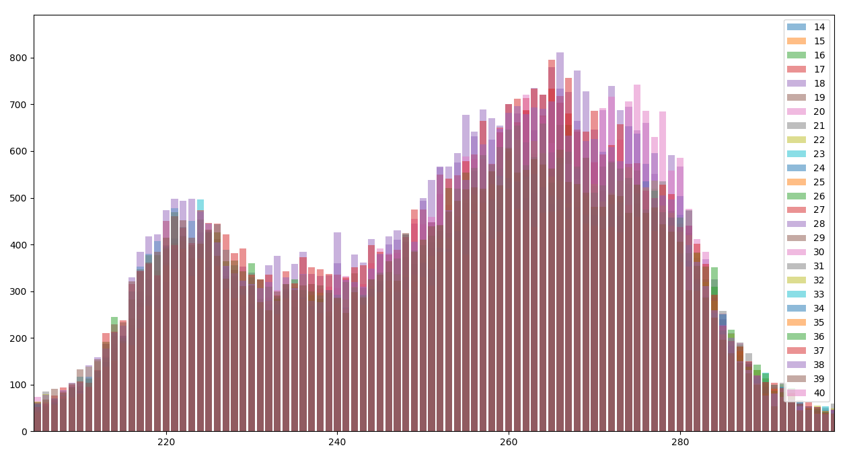

Prior knowledge:
Understand the patterns in data and create probability function based on patterns
All weeks have a similar behavior (location and time wise)
$$p\left(n_{events} | t,x,y\right)=\frac{1}{k}\sum_{i=1}^{k}{n_{events}}$$
K = number of weeks , t=time index ,
x,y = location index
$p\left(n_{events} | t,x,y\right)$ – probability of having n events at location x, y and time t
t - day, hour and minute during the week ($0≤t≤336)$
Step 2 : Probability Function, Average
Evening peak home
Morning peak to work
Notes:
before approaching the problem with advanced techniques like ML we decided to try and predict the data using the daily and weekly pattern we found.
for each time and location we can calculate the probability of n events (as a sum of all the times that number of events happened divided by the number of data points we have)
now, given a location and time we can draw the amount of events

Slide 16
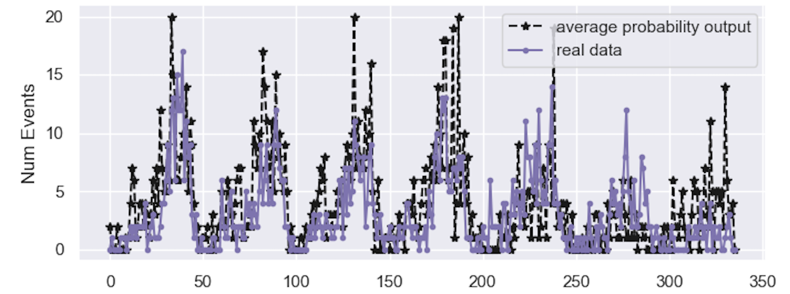
Step 2 : Probability Function, Average
Notes:
here we can see a comparison between the probability function and real data.
this graph was produced by some of the data that was NOT used for creating the probability function.
we can see that there is a good comparison between the 2.
in the GIF we can see on the right the predicted results and on the left the real data.
each figure is a different time and the locations they are found
the color presents the amount of events at that time and location

Slide 17
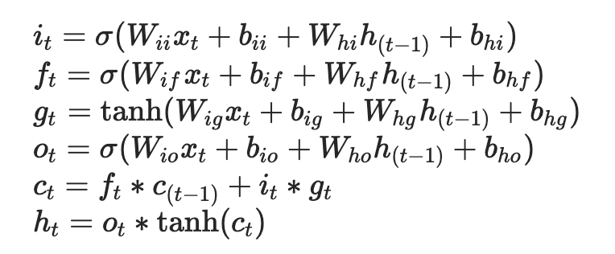
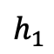
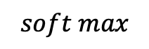
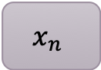
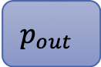
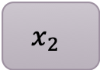
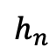
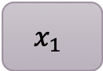

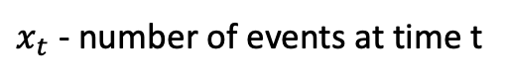
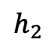
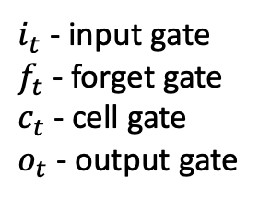
Data is sparse and therefore the network was trained on a busy node and then validated and tested on other nodes. (LSTM + FC network)
$x_{t}$ - number of events at time t
LSTM algorithm :
Step 2 : Probability Function, Machine Learning
$i_{t}$ - input gate
$f_{t}$ - forget gate
$c_{t}$ - cell gate
$o_{t}$ - output gate
Number of events at n timesteps back
$$x_{1}$$
$$x_{2}$$
$$x_{n}$$
Probability of having k events
lstm
lstm
…
lstm
fc
$$y_{out}$$
$$p_{out}$$
$$h_{1}$$
$$h_{2}$$
$$h_{n}$$
$$soft max$$
Notes:
another approach we used are classic known ML algorithms for learning the request distribution.
at first we tried using a network that combines CNN and LSTM for understanding the spatial and temporal behaviour but we quickly noticed that most of the spatial data is sparse and produces 0 for any time so the network learnt to always output 0 :)
because we noticed that, we decided to take one location that seemed busy and train a single LSTM on it assuming that at each time we have n previous time steps and predict the following time
most ppl know what an LSTM is, in short it is a network that knows how to remember information when needed, but also forget un-important data and then predict the following time step assuming that.

Slide 18
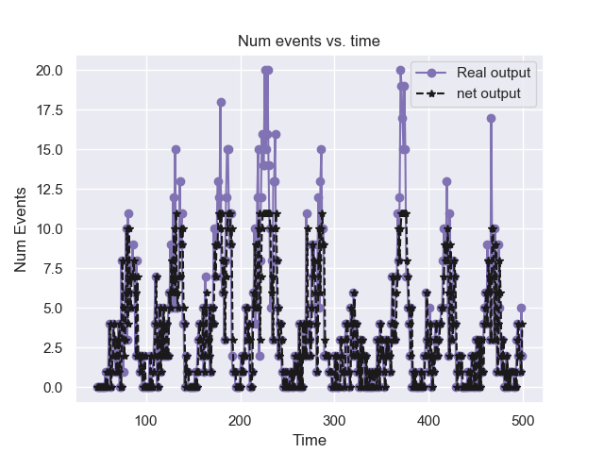
Network was evaluated on two types of data: raw, smooth
Input to network : k previous timesteps (k is a limited hyperparameter)
Step 2 : Probability Function, Machine Learning
Network results compared to raw data on busy location
Notes:
Here we can see a comparison between the network and the real data
In order to train the network we first smoothed the data and made it easier for the network to see traits (like rise in amount of events).
We can see here a comparison between the network and real data when once the input is the smooth data and the other one is the non smooth data.
We can see that for the most part the network predicts the events well

Slide 19
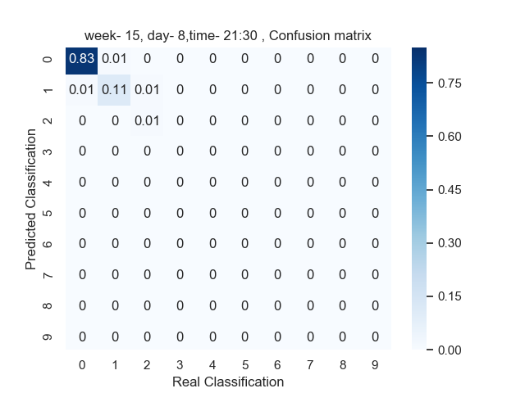
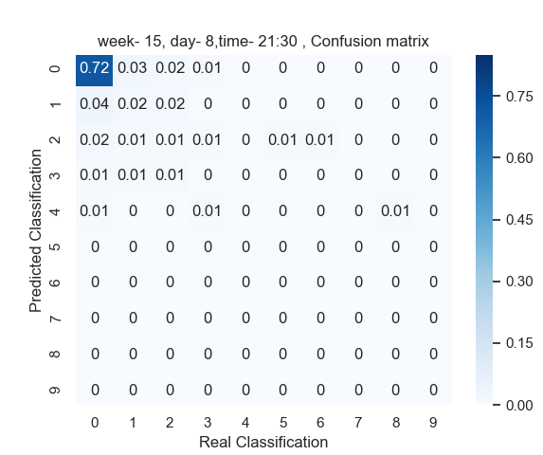
Neural network
Prior knowledge
Step 2 : Probability Function, Comparison
Neural network predicts true results better
Prior knowledge has more spread out false results (assumes higher number of simultaneous events)

Slide 20
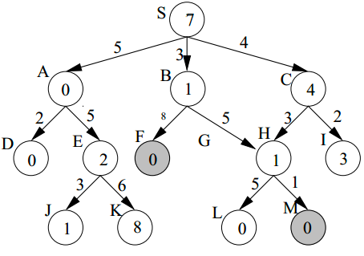
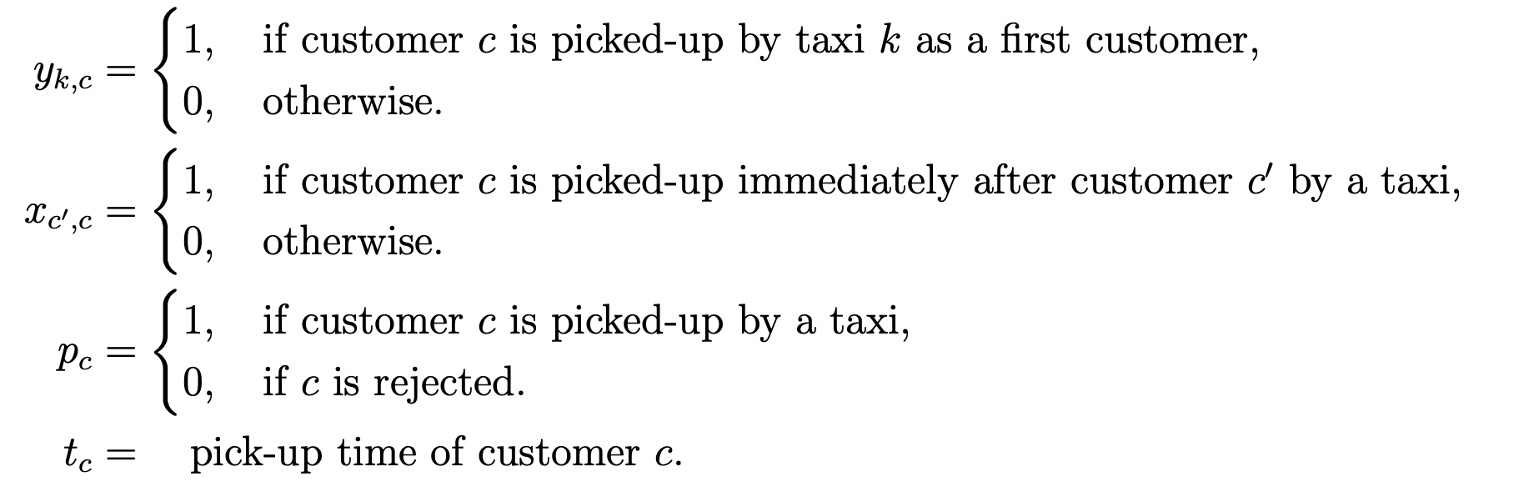
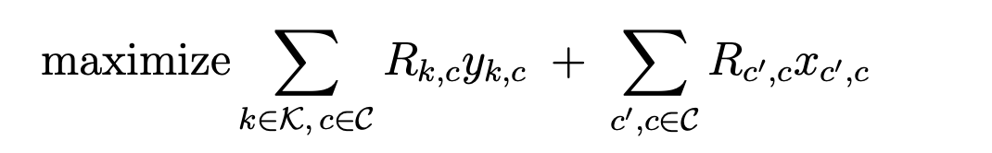
A* :
Find shortest path assuming the actual cost of each edge and the approximate future cost. Method uses BFS algorithm
MIP :
Find solution to optimization problem where the edges of the graphs are the unknown variables of optimization problem
Step 3 : Deterministic solver
In the process …
Reinforcement learning :
Learn the combined optimal policy for all cars using reinforcement learning methods
Notes:
next we wanted to find an algorithm that can solve the determinstic problem.
we tried different approaches each with its own benefits.
the 3 main approaches are : A*, MIP and reinforcement learning which we are working on now.
in the next few slides i will explain a little more about the first 2 methods.

Slide 21
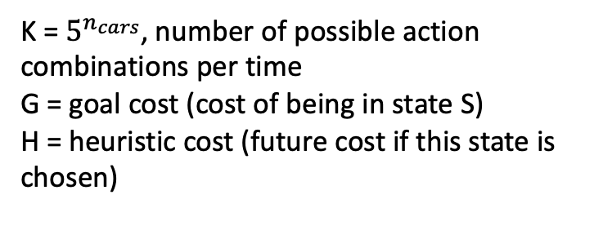
State:
Request information -
Location
Time until opened
Time until closed
Status (closed/opened)
Reward for reaching request
Penalty for canceling request
Car information –
Current location
List of requests reached
Step 3 :
A* explained
S1
$$s_{1,1}$$
𝑠_1,1
$$s_{1,3}$$
𝑠_1,3
$$S_{1,k}$$
𝑆_(1,𝑘)
$$s_{1,2}$$
𝑠_1,2
$$s_{1,1,1}$$
𝑠_1,1,1
$$s_{1,1,2}$$
𝑠_1,1,2
$$s_{1,1,k}$$
𝑠_(1,1,𝑘)
$$s_{1,2,1}$$
𝑠_1,2,1
$$s_{1,2,2}$$
𝑠_1,2,2
$$s_{1,2,k}$$
𝑠_(1,2,𝑘)
$$s_{1,3,1}$$
𝑠_1,3,1
$$s_{1,3,2}$$
𝑠_1,3,2
$$s_{1,3,k}$$
𝑠_(1,3,𝑘)
$$s_{1,k,1}$$
𝑠_(1,𝑘,1)
$$s_{1,k,2}$$
𝑠_(1,𝑘,2)
$$s_{1,k,k}$$
𝑠_(1,𝑘,𝑘)
…
K = $5^{n_{cars}}$, number of possible action combinations per time
G = goal cost (cost of being in state S)
H = heuristic cost (future cost if this state is chosen)
…
…
…
…
Notes:
for our A* method we defined the system state as the following and divided it into 2 main categories.
the 1st representing the requests and the 2nd representing the cars.
each state represents a different possible outcome of actions.
each child is another combination possible from its parent.
in the end we can see that we have many combinations at each time which makes this process pretty slow.

Slide 22

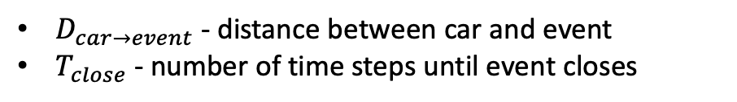
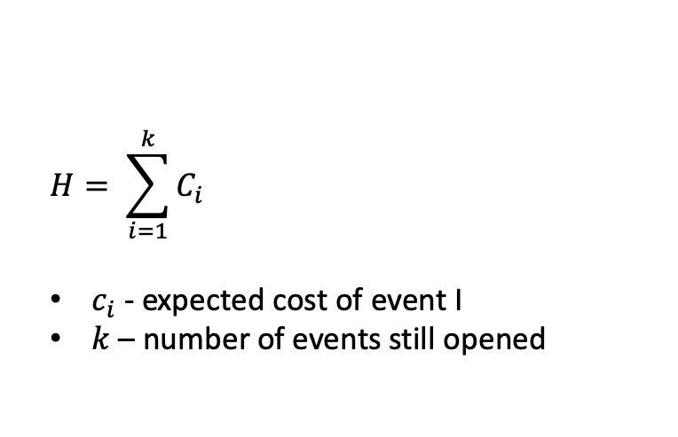
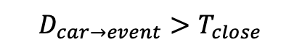
$$H= \sum_{i=1}^{k}{C_{i}}$$
$c_{i}$ - expected cost of event I
$k$ – number of events still opened
For each future/open event:
Step 3 :
A* heuristic
Find nearest car to event
$$D_{car→event}>T_{close}$$
$$D_{car→event}<T_{close}$$
Add cost of event being canceled
Add cost of driving to event + cost of event waiting + reward for closing event
$D_{car→event}$ - distance between car and event
$T_{close}$ - number of time steps until event closes
Notes:
here we can see the heuristic we used for the A* method.
for each state we reached we wanted to calculate how valuable it was for our policy to be in this state.
we went over all events that were not closed or canceled and checked which car is closest to it and then if possible to close it (assuming the distance is smaller than the time left until that event closes) we calculated the reward of closing it and the cost of reaching it
and for each event that could not be closed we added a cancelation cost
altogether this calculation represents a non realistic but optimistic reality where one car can answer multiple requests simultaneously

Slide 23
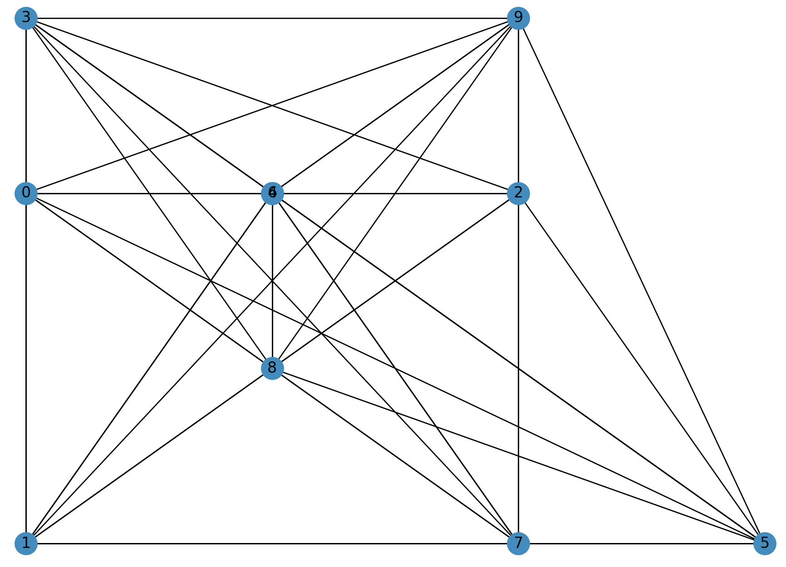
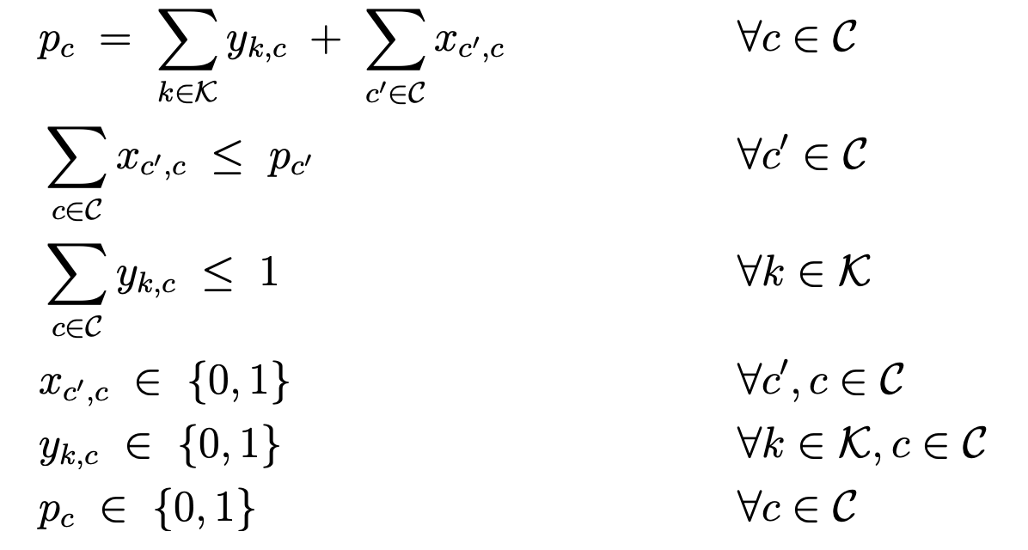


Variables
$y_{k,c}$ - indicator if request c if first in car k’s route
$x_{c^{′},c}$ - indicator if request c is picked up after request c’
$p_{c}$ - indicator if request c is picked up
$R_{c^{′},c }$ – reward for choosing path c’,c
$t_{c}$ - time request c is picked up
Step 3 :
MIP
explained
Constraints
Online Vehicle Routing: The Edge of Optimization in Large-Scale Applications. Operations Research 67(1): 143-162 (2019) Dimitris Bertsimas, Patrick Jaillet, S´ebastien Martin
Notes:
here we can see the same problem represented as a graph instead of a tree.
Each node in the graph is a different request that needs to be picked up and each edge is the route between two nodes.
The variables of the MIP are the indicators if to choose a path or not

Slide 24


Example :
$$n_{cars}=10$$
$$n_{events}=41$$
$$grid_{size}=30∗30$$
Problem layout
Step 3 :
MIP
explained
requests
cars
Online Vehicle Routing: The Edge of Optimization in Large-Scale Applications. Operations Research 67(1): 143-162 (2019) Dimitris Bertsimas, Patrick Jaillet, S´ebastien Martin
Notes:
Here we can see a small example of a case we solved using MIP.
The pink dots represent the car locations and the black dots show the requests

Slide 25



Fully connected graph, since each request can be potentially picked up after every other request
Full action space
Sim runtime - 0.55 s
Real car paths
Step 3 :
MIP
explained
Optimal solution
Only edges from optimal solution are left. Each weakly connected component in the dag is a different car’s path. (single nodes are requests that are not picked up due to cancelation)
Actual route that each car preforms (assuming Euclidian space)
Online Vehicle Routing: The Edge of Optimization in Large-Scale Applications. Operations Research 67(1): 143-162 (2019) Dimitris Bertsimas, Patrick Jaillet, S´ebastien Martin

Slide 26


For t from 1 to T:
Add new requests to S
For $i$ from 1 to N:
$f_{i} ←draw_{future}\left(G,H\right)$
For each action $a$ possible in W:
$s^{′}← <a\left(w\right), g>$
For $i$ from 1 to N:
$m_{i}←solve\left(s^{′},f_{i}\right)$
$m=\frac{1}{N}∙\sum_{i=1}^{N}{m_{i}}$
$Q\left(s,a\right)←C\left(s,a\right)+m$
Return $\underset{a}{argmin}{Q(s,a)}$
Move each car by action chosen and calculate cost and close requests reached by cars
N – number of stochastic runs (for estimating expected value of future requests)
$draw_{future}\left(G,H\right)$- assuming H future time steps, draw future requests from distribution function
Possible actions in W – all possible combinations for car movements ($5^{k}$ options per time step)
$solve\left(s^{′},f_{i}\right)$ - deterministic solver
m – expected value of future requests
Step 4 :
Anticipatory Algorithm

Slide 27


Comparing different prediction algorithms -
Step 4 :
Anticipatory Algorithm
$N_{cars}$ : 3
Grid size: 10*15
$N_{stochastic}$: 10
H: 7
Results with simple prediction function are as good as results with Neural network
Notes:
/Users/chanaross/dev/Thesis/Simulation/Anticipitory/with_machine_learning/NumCars/Results/SimAnticipatoryMio_RandomChoice_7lpred_1000startTime_10gridX_15gridY_55numEvents_10nStochastic_3numCars_Bm_easy_MaxFlow

Slide 28


For t from 1 to T:
Add new requests to S
For $i$ from 1 to N:
$f_{i} ←draw_{future}\left(G,H\right)$
For each action $a$ possible in W:
$s^{′}← <a\left(w\right), g>$
For $i$ from 1 to N:
$m_{i}←solve\left(s^{′},f_{i}\right)$
$m=\frac{1}{N}∙\sum_{i=1}^{N}{m_{i}}$
$Q\left(s,a\right)←C\left(s,a\right)+m$
Return $\underset{a}{argmin}{Q(s,a)}$
Move each car by action chosen and calculate cost and close requests reached by cars
Run only a subset of possible actions:
Randomize order of cars and run optimization for each car movement separately ($5∙k$ steps instead of $5^{k}$)
Calculate cost of dual movements (each time 2 cars move in all 5 options) and then run mini optimization to find optimal result
Step 5 :
Optimize Run-Time
Reduce deterministic run time:
Run Max flow problem instead of time window (shortens run time gradually since can be run without integer constraints)
Run reinforcement learning on deterministic problem. (shortens run time since now can run all action combinations as batch)

Slide 29


Step 5 :
Optimize Run-Time
$N_{cars}$ : 10
Grid size: 10*25
$N_{stochastic}$: 20
H: 5
Greedy anticipatory solution preforms very well, better than deterministic without time window and solution is not far from optimal solution
Notes:
/Users/chanaross/dev/Thesis/Simulation/Anticipitory/with_machine_learning/Results_presentation/SimAnticipatoryMio_RandomChoice_5lpred_4delOpen_48startTime_10gridX_25gridY_84numEvents_20nStochastic_10numCars_Bm_MaxFlow

Slide 30

Step 5 :
Optimize Run-Time
cars
Requests

Slide 31
Anticipatory algorithm result:
Greedy algorithm result:
Step 5 :
Optimize Run-Time
$N_{cars}$ : 10
Grid size: 10*25
$N_{stochastic}$: 20
H: 5

Slide 32
use reinforcement learning methods on the deterministic problem and run anticipatory algorithm in real time on larger problem
Calculate the stochastic problem using reinforcement learning and anticipatory as the Cost of algorithm
Future work

Slide 33
Input: nodes of graph
Problem is represented as graph
Nodes : locations of all requests
Edges : routes between requests
Encoder –
Multi head attention
Reinforcement learning
mTSP
Input to decoder : available nodes + graph embedding
Decoder car 1 –
Multi head attention
Decoder car 2 –
Multi head attention
Decoder car k –
Multi head attention
…
Fully connected layer
Attention, Learn to Solve Routing Problems!, International Conference on Learning Representations
Wouter Kool and Herke van Hoof and Max Welling
output: k probability functions, each one represents if car k will pick up nodes that are still available

Slide 34
Many problems today can be formalized as a number of agents and requests needed to be answered
We suggest an algorithm that uses historical data in order to plan better for the unknown future
Our solution is like the anticipatory online algorithm and adds the prediction learner
We show great results on a real-life problem : uber in Manhattan
We were able to optimize run-time using gurobi and defining the internal optimization problem as a MIP
The anticipatory algorithm shows similar results to the optimal deterministic solution
Summary

Slide 35
Input: nodes of graph
Problem is represented as graph
Nodes : locations of all requests
Edges : routes between requests
Encoder –
Multi head attention
Reinforcement learning
mTSP
Input to decoder : available nodes + graph embedding
Decoder car 1 –
Multi head attention
Decoder car 2 –
Multi head attention
Decoder car k –
Multi head attention
…
Fully connected layer
Attention, Learn to Solve Routing Problems!, International Conference on Learning Representations
Wouter Kool and Herke van Hoof and Max Welling
output: k probability functions, each one represents if car k will pick up nodes that are still available

Slide 36
Encoder –
Multi head attention
X : graph where each node is a location and connected to all nodes around it [n_batches, n_nodes, n_features]
Features: [x, y, n_cars, n_events] (in the future some sort of heatmap representation)
Multi attention layer
Output: embedding for each node in graph,using attention model [n_batches, n_nodes, n_embedding]
Decoder –
Multi head attention
X : embedded graph [n_batches, n_nodes , n_embedding]
Multi attention layer
FC layer
Output : 5 options for each car [n_batches, 5, n_cars]

Slide 37
Costumers
cars
At each time step of the RL –
Reward is the anticipatory reward of choosing action A_i for each car.
Calculate using anticipatory algorithm

Slide 38
Model logic – reinforcement learning
for e in epoch:
While (t<T)
X = graph(cars_loc, events_loc, t)
Actions = inner_model(x)
Reward = anticipatory(cars_loc, events_loc, actions)
Loss = sum(reward)
Update optimization parameters

Slide 39
functions
Graph = Make_graph(n_cars, n_events)
Action = Inner_model(graph)
Reward = calc_reward_anticipatory(n_cars, n_events, future_mat, action)
Loss = calc_total_loss(rewards)
Baseline = calc_baseline(??)

